Slide 1
Piecing it Together:
A beginner’s guide to application configuration
Mary Nagle
Software Engineer @ Warby Parker
Notes:
Thank you, name, talk title
Show hands
Learn by doing
Documentation
Me too, no technical background
Frustrating
Caught in documentation
Zero coding time
Opener - interactive
Show of hands if anyone has ever given you the advice/you believe that the best way to improve your skills as a programmer is to just do it
Show of hands if you’ve ever come across technical documentation and you had no idea what it was trying to communicate
As a beginner programmer with no technical background, this happened to me all the time
That was frustrating because when I would set out to try and build a web app for practice,
I would get caught up in documentation CLICK so full of technical terms I could not understand and I would get so bogged down I’d spend hours researching to try and understand a single page of documentation and zero time coding.
Now tell me if this sounds familiar...
Opener - straightforward
Today I'm going to talk about some beginner stuff that rarely makes its way into beginner tutorials. These things all relate to how apps run.
If you're like me, and you learned to code by learning a programming language on your own time, then it’s quite likely this area is one that eluded you for a while.
While It’s not terribly difficult to understand language syntax and how to write code, what’s less intuitive is
how an app knows when to run,
how it knows where to find its corresponding database,
what to do if you want to write an app yourself.
And it’s surprisingly difficult to find out how to do any of this from a google search. Especially at the very beginning, when you’re not even sure what terms to search for.
This talk seeks to make that process clearer. It spans everything from package installation, virtual environments, databases and application file structure, and I want to tell it in a way that almost anyone can understand - that means no jargon, and taking the time to define terms.
If you leave this talk with anything, I want you to be better-equipped to form Google queries that will help you figure out how to do this on your own.
However, I’ll do my best to teach what I can in the next 25 minutes.

Slide 2
Say What??
“SQLite is a C library that provides a lightweight disk-based database that doesn’t require a separate server process and allows accessing the database using a nonstandard variant of the SQL query language. Some applications can use SQLite for internal data storage. It’s also possible to prototype an application using SQLite and then port the code to a larger database such as PostgreSQL or Oracle.” https://docs.python.org/2/library/sqlite3.html
Notes:
SQLite example
I didn’t get this
How the hell is this supposed to help me
Docu is PITA - Good and bad documentation
Gets easier to understand with more technical concepts
so full of technical terms that I would spend hours researching to try and understand a single page of documentation and zero time coding.
For example, this paragraph from documentation for the SQLite database is full of technical terms and jargon that I did not understand as a beginner. In fact, I formatted this paragraph just so when I first made this talk to highlight terms that I did not understand, in italics if they’re jargon and bold if they’re too advanced.
How could I make a decision about whether to use this in my app if I can’t understand the description?
Is this issue ringing any bells?
There’s a lot of documentation out there - some of it’s good, but a lot of it is really hard to understand, and I’m here to tell you that that’s ok! It gets easier to understand with the more technical concepts you learn.

Slide 3
What you’ll learn
Package installation
Virtual environment
Data storage
Framework
Tying your components together
Connecting your app to the web
Notes:
We’ll cover tech concepts that come up in app dev
Documentation
Google queries
For this talk, we’re going to cover the technical concepts that come up in application development
So that you can both better understand the documentation that you’ll come across,
And also form better Google queries. Let me explain what I mean by that

Slide 4
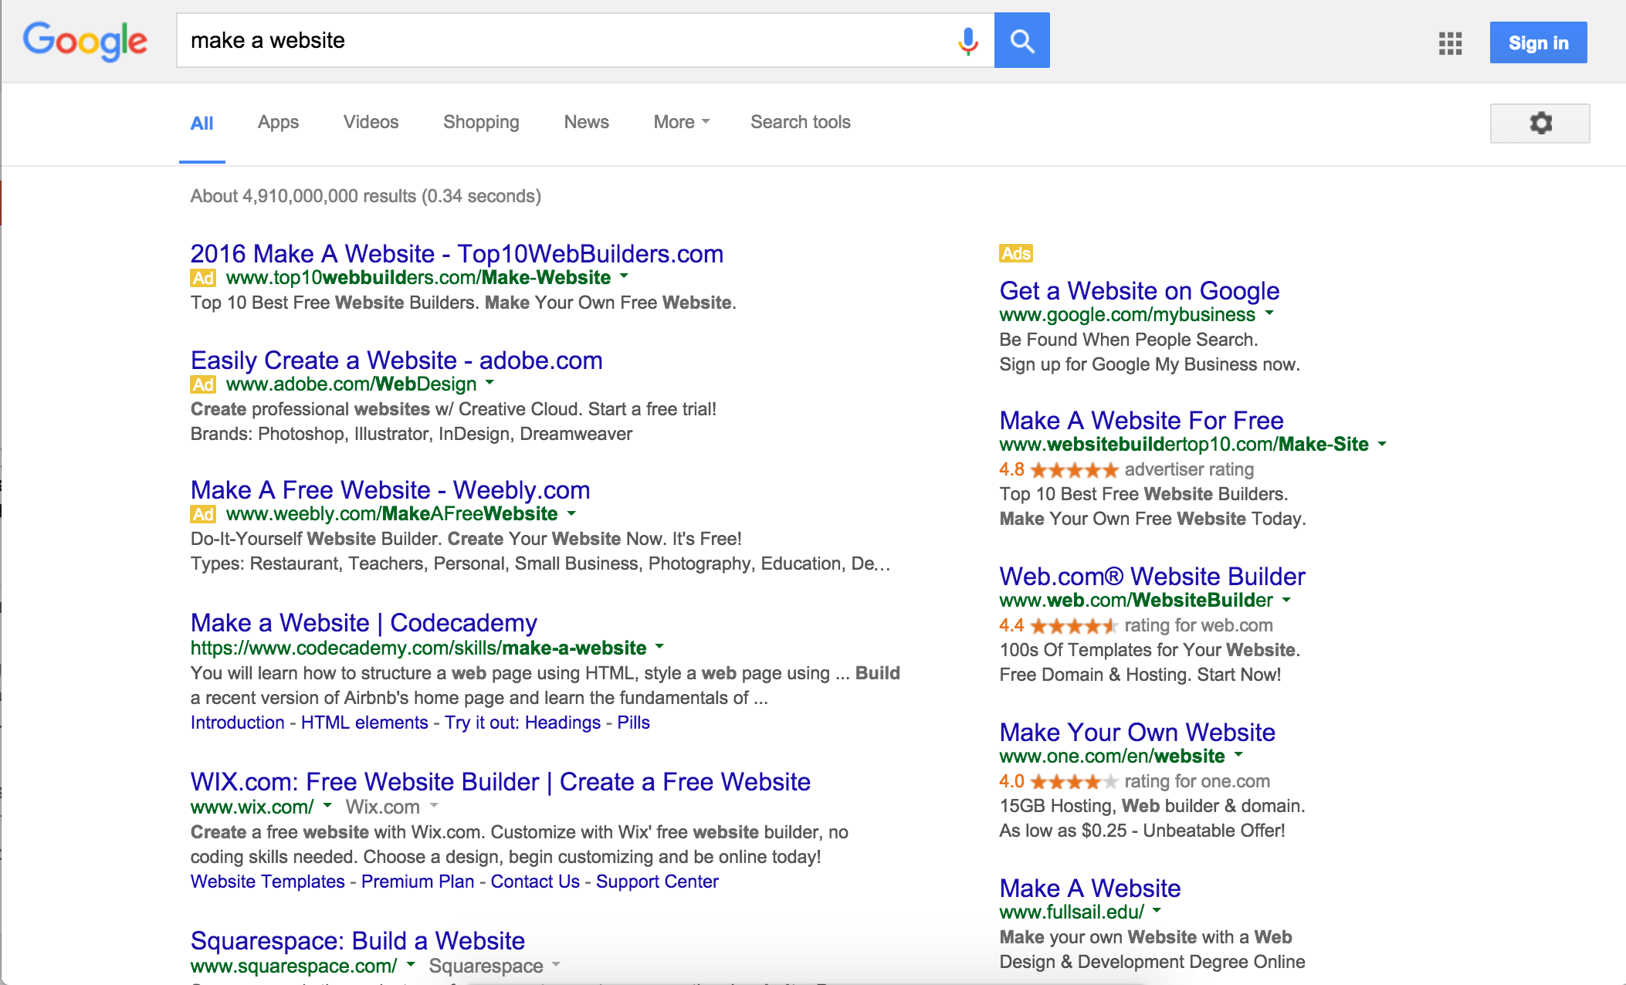
Notes:
First google
Adds, Squarespace
HTML webpage
You, a beginner programmer, want to build a website, either for practice or forreal.
And so you google, ‘build a website’. This is what you see.
You have a squarespace type tool, a tutorial that tells you how to make an HTML webpage, but none of the meaty technical stuff that you’re looking for.

Slide 5
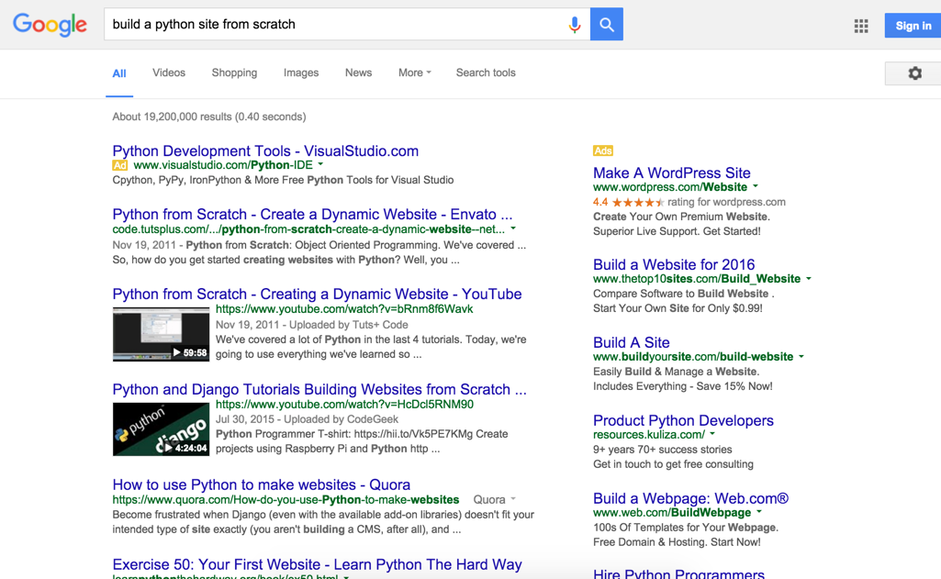
Notes:
Second google
Nothing comprehensive, start to finish
Partly bc you don’t know tech terms
You refine your query, but still don’t find anything that tells you comprehensively what you ought to do from start to finish in order to get a website up and running.
This is partly because of your google search - As a beginner, you don’t know the technical terms you need to search to get the best and most helpful results.

Slide 6
Notes:
This is to say, there is a TON of information out there related to this topic
Finding helpful information and sifting through it is hard
Googling is hard
While we’re gonna get specific about how to build an app
Underlying goal of this talk is to make that process easier and set you up with the knowledge you need to help yourself as you go through the steps of making a web app
Getting specific helps
Way to do that is to know more tech terms
You’re going to learn a lot in this talk, but the most valuable and easiest to implement takeaway will be the ability to form google queries that help you find the best information to help you.
I have found that being as specific as possible with technical terms yields the best results. For example, if I were to look up how to build a website, I might search something like this:

Slide 7
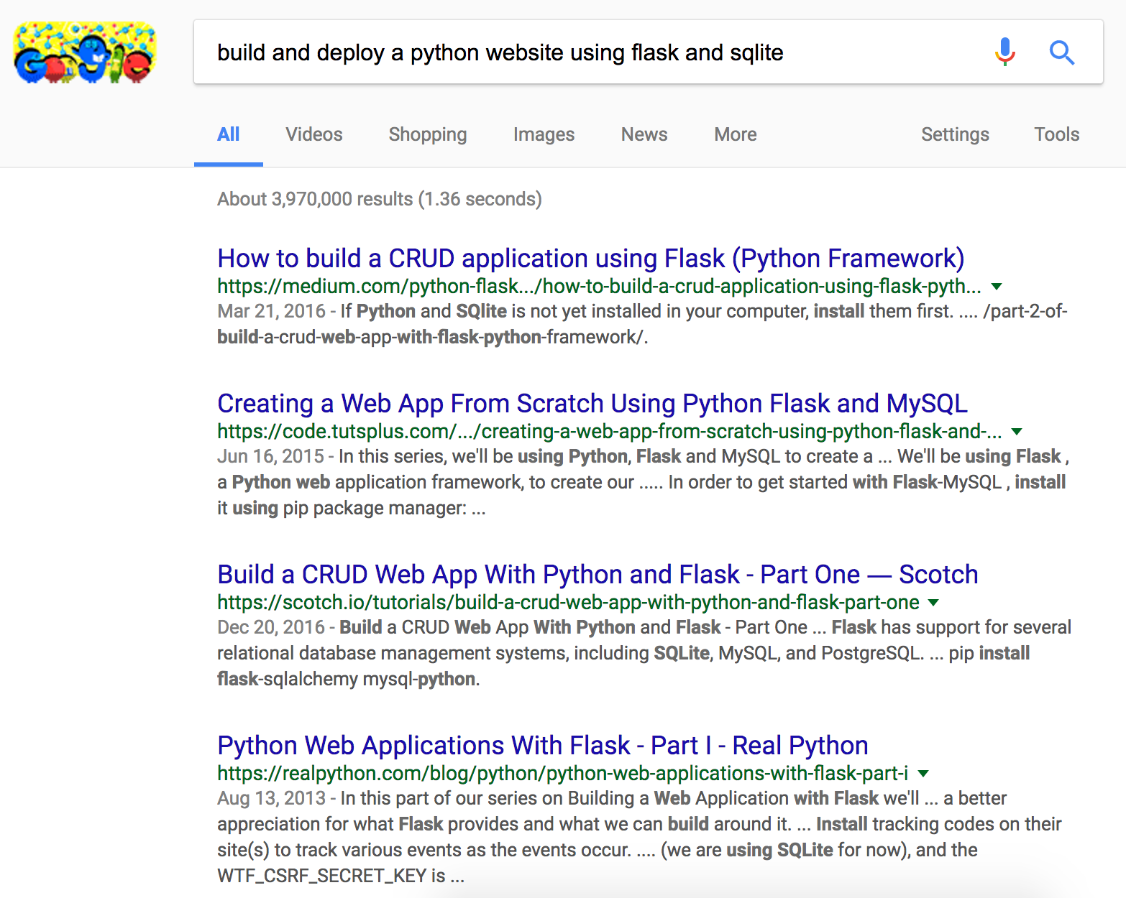
Notes:
My google example
No ads, just useful
By the end of this talk
Use these terms to understand docu
Use for google
Even so, none of these tutorials or any of the more robust tutorials that you’ll find explain WHY you might want to use one tech over the other
Build and deploy a python website using flask and sqlite
“Build and deploy a python website using flask and sqlite”
You see no ads for GUI tools, only four very useful results that will help you get a website up and running.
After this talk, you’ll be able to form more helpful queries, like this one.

Slide 8
Notes:
Frustrating but understandable
Who has time for that?
Talk is same
What both application development - and admittedly cooking - lack are tutorials that take you through the full scope of developing a recipe and telling you what ingredients are available for each step and why you might use one over the other.
While that’s frustrating, it’s also understandable, because there are so many possible combinations of what you can do to build a website and neither the author of the tutorial nor you have the time to weed through all of that.
This talk is no exception. I have approx. 27 minutes left to teach you how to build a web app in Python, without using confusing technical jargon. While we will get into specific technologies, including the meat of how they work, the primary goal of this talk is not to teach you a specific recipe for building a website.

Slide 9

Expect to leave here with...
Shiny new words in your technical vocabulary
Knowledge of steps to build an app
A better idea of how to choose components for you next app
A sample app “recipe” tailored to beginners
Notes:
Arm with tech vocab for google and docu
Google & Docu
Ground-up of what to do for web app
Key benefits of ingredients to empower choices
Provide recipe for building a website.
Going to cover a lot, absorb what you can
Slides will eventually be on my github page,
Last slide will sum up the key terms

Slide 10
What you’ll learn
Package installation
Virtual environment
Data storage
Framework
Tying your components together
Connecting your app to the web
Notes:
First four are key components
Discuss major functions of each
Popular options for each
Finish off
How to connect them to app
How to connect app to web
These first four items are the key components of building an app - package installation, virtual environments, data storage, and frameworks. We’ll talk about the major functions of each, and then finish off with some guidance on how how to connect them to each other and information on how your app connects to the web.

Slide 11

Notes:
Can think of what we go through here as a recipe ESP first 4
Cooking, use diff ingredients = taste different
App dev, use diff technologies = function differently
More advanced you become
What fits what situation
What goes well together
I say recipe because putting an app together is like building a recipe of the different components you want. When you’re cooking CLICK,
different combinations of ingredients will render something edible, but it will taste different based on what’s in it. Similarly with building an app, it will function differently depending on what ingredients you decide to use. In either situation, as you get more advanced, you will get better at knowing what ingredients suit which situations and which ones work well together.

Slide 12

What you’ve got so far
Your operating system
(This is what computers look like, right?)
Notes:
You & OS
Build on as we go
To start we have you, and your operating system. We’ll build on this as we go.

Slide 13
Installation
Virtual Environments
Databases
Frameworks
Web Servers
Notes:
Frameworks, dbs, venvs
All these components require installation or pkgs that do
PI tricky as beginner
Want best choice
Need to navigate tech docu
Walk thru common terms found in pkg docu
Once you know, you ignore
So, we have all these components - virtual environments, frameworks, data storage, and the thing about these components is that each will require some sort of installation, or at the very least will depend on other packages that require installation.
Package installation can be tricky as a beginner, because you want to make the best choice about which packages to install. In order to make that choice, you’ll need to navigate Python package documentation, which, as you may know, can be dense reading for a beginner. I’m going to walk you through some common terms often found in package documentation. Once you know what they mean, you can feel free to ignore them and focus on what the package actually does.

Slide 14
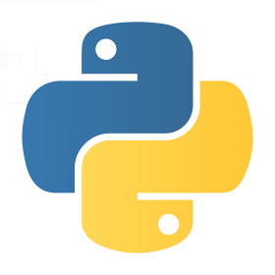
PyPI - the Python Package Index
Notes:
Explain packages
Extension of language
Simplify complex operations
Provide useful debug tools or http handling
In this section you might hear me use the words “package” and distribution
Subtle diff
Pkg just functional, import
Dist is full shabang w/ config & whatnot, install
Interchangeably here
For those of you unsure what I’m talking about when I say “packages,” let me explain.
Python as a whole is full of modules that are basically extensions of the python language itself.
The packages available are collections of modules that can simplify complex operations or provide you with useful tools for debugging, handling http requests, etc.

Slide 15
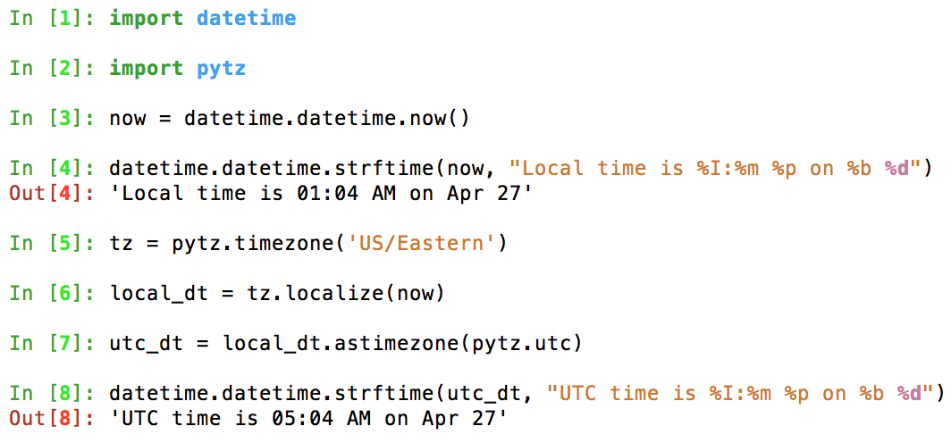
Notes:
Simple but common - ipython
Whacky colors
Python console on steroids, highly recommend
Using it to run pytz, another example
Here I import pytz and use one of its methods to convert dt to UTC
A simple but common example is pytz, which allows you to manipulate timezones on datetime objects.
Here I import the pytz package, which gives me just the core functionality of pytz, rather than every single file that makes it up.
I use it to convert a datetime object into UTC time. You can see by comparing lines 4 and 8 that after the conversion both the date and time have changed to reflect the equivalent time in UTC.
A package can also be a tool that’s helpful - these weird colors are in here because I’m using iPython rather than the system python in my terminal.

Slide 16

Notes:
To use pytz, or iPython, have to install it.

Slide 17
PyPI - the Python Package Index
Notes:
Can find on PyPI
Follow installation instructions

Slide 18
Say What??
“This package can either be installed from a .egg file using setuptools, or from the tarball using the standard Python distutils.”
https://pypi.python.org/pypi/pytz
Notes:
Hit tech docu problem
Pytz docu example
Raise hand if don’t understand
Before talk, I understood none
Most of words are super prevalent
Create obstacle
Remove obstacle in next few slides
Unfortunately, as I mentioned, here, you run into the jargon problem of documentation again.
I kid you not, this example is from the installation instructions on the pytz PyPI page.
INTERACT - Raise your hand if any part of this sentence doesn’t make sense to you
What is it even saying? Before I made this talk, I understood NONE of the technical terms in this sentence.
In these next few slides, I’ll try to clear these up for you so that you feel confident installing whatever packages you need.

Slide 19
These words don’t matter
wheels
setuptools
pip
vs.
vs.
vs.
eggs
distutils
easy_install
(package formats)
(ways to distribute packages)
(package installers)
Notes:
These six come up all the time
Rather than let them trip you up like me, rest easy, they don’t matter
These six words pop up all. the. time in package installation documentation. Rather than have you encounter them and get tripped up by them, like I did, I’m here to tell you that for you, as the consumer of a package looking to install it, they don’t matter.

Slide 20
These words don’t matter
wheels
setuptools
pip
vs.
vs.
vs.
eggs
distutils
easy_install
(package formats)
(ways to distribute packages)
(package installers)
Notes:
First 4 especially
If you want highly tech descrip, you can google, lotsa blogs
But giving just high level so you have some idea
Especially these first four. I can go into a lot of technical detail about what the differences between them, but due to time restrictions and entertainment value that’s probably a bad idea, so in case you’re curious, I’ll leave you with this:
As the consumer of the package, you really only need to think about the last pair on this slide - pip and easy_install, which are used to install packages on the command line. However, in package documentation you will see all of these terms that provide a bit more technical detail.
You only need to worry about the first two pairs if you are writing a package for distribution. All three sets are hotly contested in some circles. And before we move on, in case any of you out there feel strongly either way, I just want to say I am not trying to start any fights here, but here we go.
???Basically it comes down to the matter of how a distribution should be formatted, how it should be distributed, and how to install it. NEXT

Slide 21


wheels vs. eggs
Easier to make both Python 2 and Python 3 compatible
More difficult to make Python 2 and Python 3 compatible
Notes:
W&E = pkg format like zip
Wheels preferred bc python 2&3
Either usable, but this will never matter to you
If curious, google
Eggs and wheels are package formats kind of like .zip. Wheels are generally preferred these days because they are easier to make both python 2 and 3 compatible, but either are usable, and in almost every case it will not matter on your end which format the package comes in.
If you’d like to know more, there are lots of blog posts on these.

Slide 22
setuptools vs. distutils
Does everything distutils does, and then some.
Notes:
S&D ways to distribute pkgs for installation on PyPI
Specifically carry installation script
Gets info from egg or wheel
Setuptools > Distutils
Then there’s setuptools and distutils, which are ways to distribute packages on PyPI - that is, they contain the scripts that run installation
Setuptools is built on top of distutils. It does everything distutils does, and then some. In fact I started to look into what distutils does and what benefits it has NEXT SLIDE

Slide 23
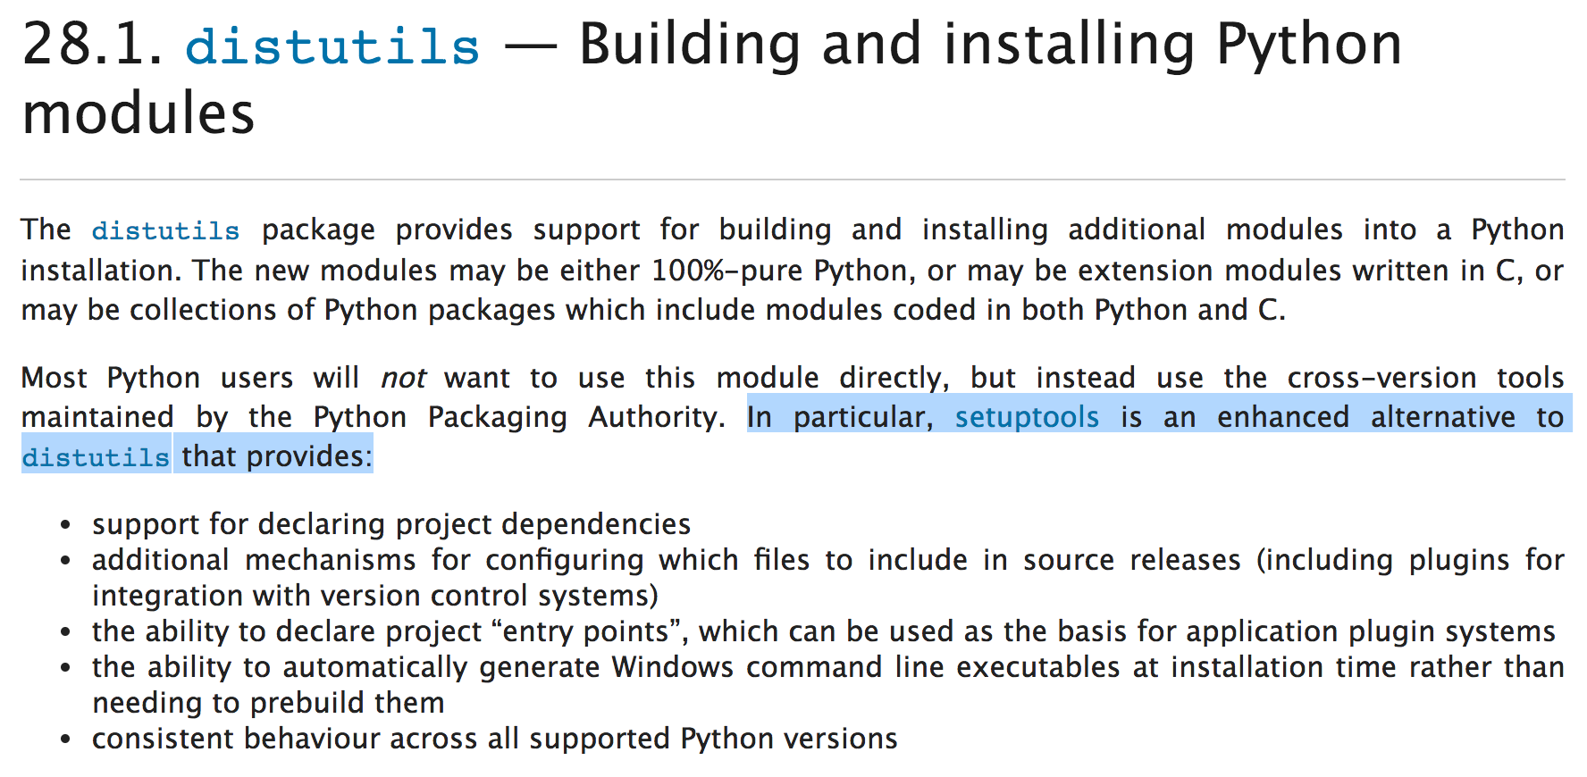
...
Notes:
Still doesn’t matter
But then stopped when I saw that by the second paragraph of the distutils documentation it all but tells you to use setuptools instead, and then proceeds to list the benefits of setuptools
Again, you don’t even need to know this if you are downloading a package - the only time you may have a choice, is with CLICK

Slide 24
pip
easy_install
vs.
Notes:
Only time you as consumer have choice
Command line, trigger installation scripts
Common diff = pip = wheels and easy_ = eggs
Lot of overlap in what they do
pip and easy_install
These are command line commands that allow you to quickly install other packages. They trigger the install scripts to run.
Most packages will allow you to use either
Their most commonly referred to difference is that pip works more easily with wheels, while easy_install works more easily with eggs, but there’s a lot of overlap in what they do.

Slide 25
Recommendation: Use pip
Notes:
If unsure, use pip
More prevalent
Faster
Introduced req.txt
But, if you are unsure which to start with, use pip. Pip is a good bet because it’s much more prevalent than easy_install, and it works faster than easy_install. It also introduced the idea of a CLICK requirements.txt

Slide 26
requirements.txt
flask==0.10.1
pytz==2016.4
psycopg2==2.6.2
requests==2.13.0
SQLAlchemy==1.1.1
Notes:
Include in your python app
Lists each pkg and version
Pip
Makes easy to generate
File makes easy to replicate envs
To add some technical detail, here’s how pip and easy_ work
File, which is a file you include in your python app that lists each
package your app uses and the version that should be used.
Introduced this idea
Easy to generate
Useful for installing dependencies
Easy to replicate environments

Slide 27
Find packages
2. Install packages
3. Resolve conflicts
Notes:
Differ in how they do it
Both
Find pkgs
Generate metadata from setuptools
Install
Use setup.py file
Include dependencies
Resolve conflicts between ones being installed and ones on sys
They just have different ways of doing it.
Find packages by generating metadata from setuptools and querying this data using the pkg_resources module
Use the setup.py file to execute these installations
And install them into your computer’s site-packages directory
Both include the packages’ dependencies in those installations
resolve conflicts between the packages being installed and those that already exist on the system

Slide 28
3. Resolve conflicts
Notes:
Resolve is main diff
The main difference between them comes from how they resolve conflicts

Slide 29
pip uninstalls dependencies that do not match the required version
easy_install allows different versions of a specific package in a single environment
Notes:
Pip uninstalls
Easy_ allows diff versions of pkg on system
pip does this by booting out any pre-installed versions that don’t fit the requirements, while easy_install allows different versions of a package in a single environment.

Slide 30
...then how does the app know which version to use?
Notes:
Going to attempt to demystify how easy_install knows which version to use
So given that easy_install allows multiple versions of a package on a single system, the natural question that follows is how does an app or package know which one to use?
By default, an app will use the most recently installed version of a package. However, easy_install does give you the ability to specify which version you use at runtime.

Slide 31
easy_install modifies sys.path to point to the appropriate version of a distribution
Notes:
Knows bc modifies sys.path
It is able to do this because it modifies sys.path. I had no idea what sys.path was when I set out to write this talk, so i’m going to take a moment to explain.

Slide 32
sys
Notes:
Sys is python module
Sets up vars about sys
Sys is a python module that helps set up system-specific variable definitions

Slide 33
sys.path
Notes:
Has property path
List of strings that tells file path to desired module
Sys.path is a list of strings that specifies the search path for the modules installed on your system or environment
In other words, it tells you the file path to the desired module.

Slide 34
easy_install
sys.path = ‘/path/to/file.py’
Notes:
Easy_ taks path to egg file and pushes it to front
In sum, when easy_install goes to work, it pushes the path to the distribution’s .egg file CLICK to the front of sys.path

Slide 35
easy_install
sys.path = ‘/path/to/egg/files.py,/path/to/file.py’
Notes:
Python looks for module to import
Finds this one first
to the front of sys.path, so when python looks to sys.path for a module to import, it finds the most recently-installed one first.

Slide 36
Use pip, not easy_install
Words that don’t matter: .egg, wheel, setuptools, distutils
Notes:
Now you know you can ignore
Understand docu better
Now you know, get comfy, choose other
Anaconda
Now you know these terms are safe to ignore, and can move through package documentation with a little more understanding.
At the same time, now that you know how package installers like pip work, you can get comfortable with pip and then later use a different package installer if you decide that’s what’s best for you.

Slide 37

What You’ll Learn
Package installation
Virtual environment
Data storage
Framework
Tying your components together
Connecting your app to the web
Notes:
That takes care of package installation, and now if you run into issues,

Slide 38
“Install [package name] with pip”
Notes:
Can google “install whatever package with pip” when you need help.

Slide 39
Notes:
Study pkg install = learn version mgmt of pkgs on sys is tricky
PyPI pkgs actively maintained
New versions
Sometimes back compatible
Lot of ways that can mess you up
If you read a bunch of blog posts on package installation, as I did when putting together this talk, one thing you will learn is that version management of packages on your system is a tricky problem to solve. Many PyPI packages are actively maintained and so release new versions over time. Sometimes new versions are backwards compatible, but sometimes not.

Slide 40
Your operating system
App_1
App_2
SQLAlchemy v 0.9.6
SQLAlchemy v 1.1.0
query = session.query(“customers”)
.filter_by(email=’existing@cx.com’’)
Table headers = train, smelliness
query.order_by(“smelliness desc”)
query.one_or_none()
Notes:
While there are many different ways conflicting versions can mess you up, here’s an explanation of one of the simpler scenarios in which this could happen:
Your OS
App_1, where you want to find out how NYC subway trains rank in smelliness
Sqlalchemy is a package that helps you query and perform advanced operations on data in your database.
.order_by method which allows you to specify the column and the rule by which that column should be ordered
Then you have another app where, using someone’s name,
you want to find out if they’re a customer. But if they’re not a customer, you don’t want your app to blow up.
You find this nifty .one_or_none() method in sqlalchemy, which returns either one result, or returns None if one result is not found.
In order to do this, you need to upgrade to sqlalchemy v 1.1 because that is when this method was released; it was not available in prior versions.
Now your second app works great, but when you go back to run your first app, you find that it no longer works - .order_by method was deprecated in sqlalchemy 1.1

Slide 41
Virtual Environments
Notes:
Virtualenvs solution
Allow installation of diff versions across sys
Keep isolated
So that diff apps that require diff versions still work on one sys
Some people don’t use
Fine if you know
What’s the solution? Virtual environments!
Virtual environments allow you to install different versions of packages across your system and keep them isolated from one another.
This way, apps that require different versions can still work on your system, so long as they point to the appropriate virtual environment.
Some people prefer not to use virtual environments
That’s fine if you know what you’re doing and know how to install packages on your system in such a way that they won’t step on each other’s toes or break your apps
But as a beginner, this is a super helpful, easy to use tool that can take care of that for you

Slide 42
virtualenv
(Python 2 or 3)
venv
(Python 3)
Notes:
Virtualenv and venv pkgs that create virtual envs
If using, use virtualenv
Works with python 2&3
Lots of well-written docu
Pkg on PyPI so install w/ pip
Venv built into python 3
Functions the same
Commands diff
virtualenv and venv are two python packages that create virtual environments. Activating one of these virtual environment packages is probably the first thing you will do when starting a new project.
If you’re going to use a virtual environment, I recommend you use virtualenv CLICK, because it works on Python 2 or 3 and has a lot of well-written documentation on it that will explain how it works. It’s a package on PyPi, so you can install it with pip. CLICK
Venv works pretty much identically to virtualenv, only it comes included in python 3, so the commands to get it to run are slightly different.

Slide 43
Notes:
Here you see the command to create a virtualenv,

Slide 44
Notes:
Venv command
Doing same thing
When create, specify where to live
Usually same parent folder
And here’s the command to create a venv, but they are doing the same thing.
When you create a virtual environment, you specify where you want it to live. In most cases, it’s appropriate to have your virtual environment live in the same parent folder as your application.

Slide 45
~/parent_folder/ pizza_app/ __init__.py file_1.py
requirements.txt app.py
Notes:
E.g. one in pizza_app/
I did this
For example, if I were to install or start up a virtual environment for an app I was writing called pizza app,

Slide 46
~/parent_folder/ pizza_app/ __init__.py file_1.py
requirements.txt app.py
Notes:
Point activation script to parent folder
Specifying path
Running from inside that folder
I would point the activation script to parent_folder, either by specifying the path or by running the script from inside that folder

Slide 47
~/parent_folder/
my_virtual_env/ pizza_app/ __init__.py file_1.py
requirements.txt app.py
Notes:
Is virtualenv home
Only a reco but good one for beginners
And then my virtual environment would live there. This is only recommended, but it’s a good recommendation, especially if this is your first time using virtual environments.

Slide 48
~/parent_folder/
my_virtual_env/
bin/
lib/
python2.x/
site-packages/
pizza_app/
...
Notes:
Python & pkgs live here isolated
It’s a folder with all your things plus bash script
Modifies sys variables
On creation...
All the packages you install, as well as the version of python you are using, live isolated in that virtual environment, which is really just a folder for you to keep all your things in, paired with a bash script that modifies system variables.
Here’s a brief explanation of what happens when you create a virtual environment...

Slide 49
Python virtual envs come pre-baked with their own Python binary
Notes:
Make replica of sys python
Can specify version on creation
Final p = virtualenv w/ interpreter tailored to pkgs
When code runs, compiled using that env’s python
Virtualenv and venv by default make a replica of your system python to use as their own.
However, you can specify a specific version of Python upon creation. Either way, you end up with a virtual environment that has its own python interpreter tailored specifically to the packages and python installed on that environment.
So, when your app runs code on this virtual environment, it is compiled using that environment’s Python interpreter.

Slide 50
many projects : many environments
Notes:
= App can point to any venv
Run using that specific v of python & pkgs
Won’t necessarily work
Great way to test
This means that you can point an app to whatever virtual environment you want and try to run it using that specific environment’s packages and python.
Will it run successfully? Not necessarily, because some environments might not have all the packages you need, or the python might not be compatible. However, this capability can be very useful for testing apps on different versions of packages or python.

Slide 51
How does your app know to look in the virtual environment folder’s site-packages/ and not your system’s site-packages/?
Notes:
How can app switch?
How does it know?
Bash script
In that case, how the heck does that happen? How can an app switch between virtual environments? How does it know which one to use? The answer lies in the bash script I mentioned that is a key part of virtual environments.

Slide 52
~/parent_folder source my_virtual_env/bin/activate
Notes:
To run a virtualenv, must activate
This command from parent folder to execute activation script
Once you’ve created a virtual environment, you must activate it. To do that, you run this bash script called activate using this command from the parent folder. This executes the file designated in the path you provide, which here is the activate script,

Slide 53
~/parent_folder/
my_virtual_env/
bin/
activate
lib/
pizza_app/
...
Notes:
Lives in bin/
That lives in the bin folder of your virtual env. What this script does is

Slide 54
$PATH
Notes:
Modifies $PATH
System-level var
Tells set of directories in which live executables
I.e. Tells Python where to find binary files for pkgs
Similar to sys.path mod
Prepends path to venv pkgs at beginning
It modifies your $PATH variable. This variable is a system-level variable that tells you a set of directories in which executable programs are located - in other words, this tells you in which folder to find your python interpreter and the binary files for all the packages you have installed.
Similar to the sys.path modification I mentioned before, the activate script prepends the file path to the virtual environment packages at the beginning of the $PATH variable. Then at runtime, your system will look for programs and scripts in the order the directories are listed.

Slide 55
echo $PATH
/usr/local/bin: /usr/local/sbin: /usr/bin
Notes:
BEFORE
Prior to activating a virtual environment, the $PATH variable will look something like this, with each directory separated by a colon

Slide 56
~/parent_folder source my_virtual_env/bin/activate
Notes:
Then you run the activate script,

Slide 57
echo $PATH
/Users/you/parent_folder/my_vitual_env/bin: /usr/local/bin: /usr/local/sbin: /usr/bin
Notes:
AFTER
And this time you will see that the first path is the path to the binary in your virtual environment

Slide 58
~/parent_folder deactivate
Notes:
When done, deactivate
Triggers function in activate script
Removes dirs from $PATH
When you are done working for the time being and want to reset everything, just run `deactivate`, this will trigger a function in the activate script that removes the virtual environment directories from your path

Slide 59
“Set up virtualenv”
Notes:
So, when you want to use virtual environment, you can google

Slide 60
What You’ll Learn
Package installation
Virtual environment
Data storage
Framework
Tying your components together
Connecting your app to the web
Notes:
Now venv
Looks like this
So in terms of piecing together your app, you now have the knowledge you need to install and set up a virtual environment. Here’s how it looks so far

Slide 61
What you’ve got so far
Your operating system (includes its own version of python)
virtualenv (includes its own, separate version of python)
Python & Packages installed using pip
Notes:
INTERACT
Pkgs & python on venv
Need other ingredients
You have your virtual environment living in a folder on your operating system, that has a version of python and some packages installed
This is a pretty good start. But there are other ingredients you need to build your own app, so let’s talk about those.

Slide 62
Data Storage
Notes:
Important arch decision
Don’t nec need db
JSON file
Cloud storage
Both lack setup complexity
Lack of time
Tried and true common dbs in python eco
An important architectural decision for any app is how to store data.
Technically speaking, you don’t necessarily need to set up a database to accomplish persisted data. You have a huge variety of options that don’t require the setup or have the complexity of a database. You could go as simple as using a json file in your app, or go for cloud storage, which requires some set up but is often very lightweight when compared to the configuration and schema definitions and server space required to host a database.
As there’s not time to cover all of those options, I focus here on the tried-and-true, super common databases, that you are likely to encounter in the Python ecosystem.

Slide 63


Slide 64
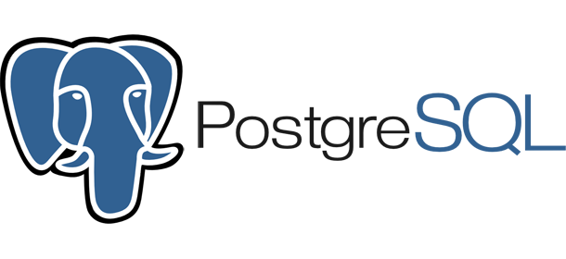

Slide 65
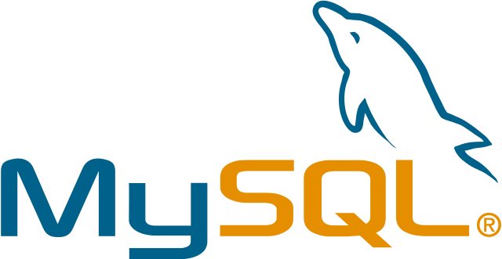

Slide 66
Notes:
Choose for pet proj or app prototype
Store entire db in single file on disk
Zoolander
SQLite is the one you choose for a light-weight pet project or an application prototype.
SQLite stores the entire database in a single file on disk. This means it lives right on your computer.

Slide 67


Slide 68
Notes:
Included in python 2.7+ so no extra pkgs req
Other two need extra pkgs
Best for small for many reasons
Doesn’t scale well
Single connection
No sharding
Advanced column types
Possible to port to larger DB
Ref docu from beginning
It’s included in Python from versions 2.7 on, so it doesn’t require any extra packages in order to be queried, as the other two do.
It’s best suited for smaller projects for many reasons, but the main reason is that it doesn’t scale well. It only supports a single connection, does not allow for sharding when rows get too big, and does not support many advanced column types.
Fortunately, it is possible to port it to a larger database once your app is ready for production.
If you’ll recall the sqlite documentation I showed at the beginning of this presentation

Slide 69
Say What??
“SQLite is a C library that provides a lightweight disk-based database that doesn’t require a separate server process and allows accessing the database using a nonstandard variant of the SQL query language. Some applications can use SQLite for internal data storage. It’s also possible to prototype an application using SQLite and then port the code to a larger database such as PostgreSQL or Oracle.” https://docs.python.org/2/library/sqlite3.html
Notes:
Starts to make more sense
This is more tech v of what I said
Last line = move to larger db
It starts to make a little more sense
It’s a slightly more technical description of what I just said, and at the end tells you my last point - that you can move data from sqlite to a larger database.

Slide 70
Notes:
Larger db solid bet =
Both
Open-source
Mature
Use MySQL for fast
Use PGSQL for reliable, SQL-compliant
For those production systems, PostgreSQL and MySQL are two solid bets. Both are available open source, and both are very mature.
In sum, you use MySQL when you need something fast, and PostgreSQL when you need something reliable and strict SQL compliance

Slide 71
Data integrity
Notes:
FAST!!!
More detail
Strict data integ
Part due to SQL compliance
Use Postgresql when you want strict data integrity - this is in part due to the SQL compliance I mentioned

Slide 72
Data integrity
Open-source & free
Notes:
FAST!!!
Open-source & free
Robust community & 3rd party support
Something open source and free with a robust community and 3rd-party support

Slide 73
Data integrity
Open-source & free
Objective relational database management
Notes:
FAST!!!
Objective storage
Support for nesting
And when you have a use for objective storage, which means you need support for nesting and the like.

Slide 74
Data integrity
Open-source & free
Objective relational database management
Speed
Notes:
FAST!!!
Lacks in performance
Read-heavy
However, it lacks in performance, especially in applications that are read-heavy.

Slide 75
Easy to work with
Notes:
Easy to set up & work with
Use MySQL when you want something easy to set up and work with

Slide 76
Easy to work with
Secure
Notes:
Advanced security features

Slide 77
Easy to work with
Secure
Fast
Notes:
And super fast even when storing large amounts of data at scale.

Slide 78
Easy to work with
Secure
Fast
Concurrency
Notes:
Simultaneous read-write ops = reliability issues
Acquired = complaints about dev process since
Also both need addt’l pkgs to work w/ app
However, simultaneous read-write operations have been known to cause reliability issues with MySQL.
Further, while it’s still open sourced, it was acquired, and there have been complaints about the development process since its acquisition.
The other kicker is that both mysql and postgresql require additional python packages in order to work properly with your app.

Slide 79
Recommendation: SQLite
Notes:
That’s high level about those BUT
It’s your first app, nothing crazy happening, so use SQLite
Easy intro into db storage
Just go w/ what suits your needs
As beginner you need
Simple & well-documented
Easily integrates w/ Python
Relatively easy to understand
= SQLite
If you’re new to data storage, SQLite is a good place to start, because it’s an easy intro into database usage.
When considering between any number of storage systems, the answer truly is “whatever suits your needs.” As a beginner, you need something simple that is well-documented, easily integrates with Python, and is relatively easy to understand compared with other options. SQLite will provide all of that.

Slide 80
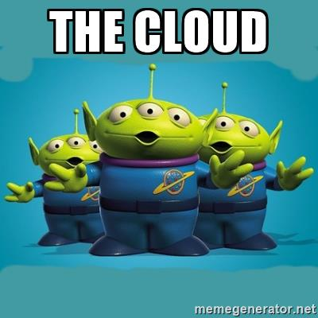
Notes:
No time
Pls reach out if curious
Unfortunately pressed for time so I do not want to dive into this, but please feel free to reach out if you would like to know more about other storage options and I can point you to some resources.

Slide 81
“Set up SQLite”
Notes:
When you want to make DB, google “Set up SQLite”

Slide 82
What You’ll Learn
Package installation
Virtual environment
Data storage
Framework
Tying your components together
Connecting your app to the web
Notes:
Now data storage has been explained, and this is how your setup looks

Slide 83
What you’ve got so far
Your operating system
virtualenv
SQLite database, kind of just chillin, not connected to anything or even initialized
Python & Packages
Notes:
INTERACT
SQLite living on OS
DBs can be stored in system in various ways
But connects to app w/ config vars
Next piece helps
In system bc it’s sqlite
Databases are great to have in your app and are stored in your system in various ways. You can connect your app to its database using configuration variables, and the next piece will help with that.

Slide 84
Web frameworks
Notes:
Also last major piece
Make dev app easier bc take care of overhead
To get why they’re important
Skipping to how app communicates w/ web
The last major piece of your app left, and that’s the web framework. Web frameworks take care of a lot of the overhead of setting up and configuring an app. However, in order to help you better understand why they are important, I’m going to skip ahead and talk about how your app communicates with the web.

Slide 85
HTTP Request HTTP Response
Notes:
Web comms w/ app thru HTTP request
Request tells app what info end user wants
App retrieves info
then packaged as HTTP response
But how does request get there, and where does response go afterward?
The web communicates with your application through an HTTP request. This request tells your application what information the end user would like from your app.
This HTTP request will map to a route in your application, and your application will match that route to a specific piece of code, which will return the information desired.
This information is packaged as an HTTP response. This contains everything from the raw HTML that dictates how your page will look, to data from your database.
For example, if I was logged in on an e-commerce site and clicked a link to my Order History, the application behind the site would grab all the relevant information on my orders from the database, and parse that into the HTML file that is the design of the Order History page. All of that information is communicated to the browser through the HTTP response.
In order for you to understand fully how that works, I’m going to tell you, as simply as possible, how HTTP works.

Slide 86
HTTP: A Short Story

Slide 87
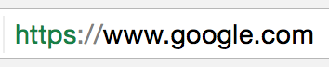

Resolver
TLD Server
(.com)
Google.com Application Servers
(IP maps to these)
IP: 173.194.175.104
Resolver
Google.com Server
-
Provides IP: 173.194.175.104
Notes:
Start w/ URL in browser
Browser needs to send that URL to app CLICK
Needs to find servers that host app
Locates those with their IP address
In order to find IP, DNS
Sends URL as request via resolver CLICK
Routed to TLDs
TLDs direct resolver to site’s name servers CLICK
Name servers hold IP of app servers and map to them
HIGH level: The URL in your browser corresponds with a route in your app. In order to match the URL with the corresponding route, DNS has to happen. DNS uses the URL to help your browser find the servers that host your application files. To start, the browser doesn’t know where to find this URL’s servers, and so sends the URL as a request via a resolver, and is routed first to the top level domain server (i.e. the .com, .org, etc.), which then directs the resolver to a site’s name servers, which provide your site’s IP address.
This IP address maps to the servers that host your application.

Slide 88

www.google.com at 173.194.175.104
Google.com Application Servers
IP: 173.194.175.104
app.py
(WSGI)
HTTP Request
HTTP Response
Notes:
Browser sends URL to those servers via HTTP req
Server receives URL and sends to web app
Matches to corresponding route
Executes appropriate code
Returns output with bunch of info
Server takes output, sends as response under HTTP headers
E.g. webpage is ‘message’
This req/resp is WSGI
The browser then sends the URL to those servers via an HTTP request. The server receives that URL and sends it to the web app, which processes that URL and matches it to the corresponding route, executes the appropriate code and returns an output with a bunch of information in it.
The server takes this output and sends it as a response under a bunch of different HTTP headers - the output that you see on your webpage is mostly stored under the “message” header
This request/response interaction is what takes place under WSGI

Slide 89
Web Server Gateway Interface
Notes:
Web Server Gateway Interface
Protocol to simplify comms over HTTP just described
Point at which web interacts with app
Web passes request to app
App passes response to web
WSGI is the Web Server Gateway Interface. WSGI is a protocol meant to simplify the communication over HTTP I just described. It is the point at which the web meets and interacts with your application, where it passes the HTTP request off to your application, and your application passes the response off to the web.

Slide 90
Provide a consistent, and relatively simple yet comprehensive interface capable of supporting all (or most) interactions between a Web server and a Web framework
Notes:
Exists to enforce this simplified consistent communication
Gnarly details
WSGI exists to enforce this simplified and consistent way of communicating between a web server and an application all across the web.
If you want to know the gnarly technical details,

Slide 91
PEP 333
Notes:
I highly recommend you look up PEP 333, which is the specification in which WSGI was formalized.

Slide 92
What You’ll Learn
Package installation
Virtual environment
Data storage
Framework
Tying your components together
Connecting your app to the web
Notes:
With that, back to frameworks

Slide 93
Web frameworks
Notes:
Take care of tedious parts of app config
So you don’t have to
Includes HTTP/WSGI business
Install like a pkg
Provide you w/ config files and skeleton structure
Can use as basis for your code
Web frameworks take care of writing the tedious parts of application configuration so that you don’t have to. That includes this HTTP/WSGI business
You install them just like you would a python package, and they provide you with configuration files and a skeleton file structure you can use as the basis of your application code.
They come pre-baked with WSGI, so that the web server knows exactly which file to look to to find the route that matches its URL.

Slide 94
Why use a web framework?
Notes:
Don’t have to use but helps with learning
Basic app structure and config
Experienced coders use them too
Lots of frameworks exist in python eco besides web frameworks
Explore to see if will make your life easier
You don’t have to! This is absolutely not required. However, as a beginner, it can be useful to use a web framework to learn how an app can be structured and what goes into basic application configuration.
Because they make things so much easier, many experienced coders regularly use frameworks, as well.
Web frameworks are most beneficial for - well, web development - but various frameworks exist throughout the Python ecosystem and it is worth exploring what’s out there to see if there’s something that will make your life easier.
Now that we’ve covered WSGI, I’m going to list four additional aspects of an application that typically come pre-baked in frameworks.

Slide 95
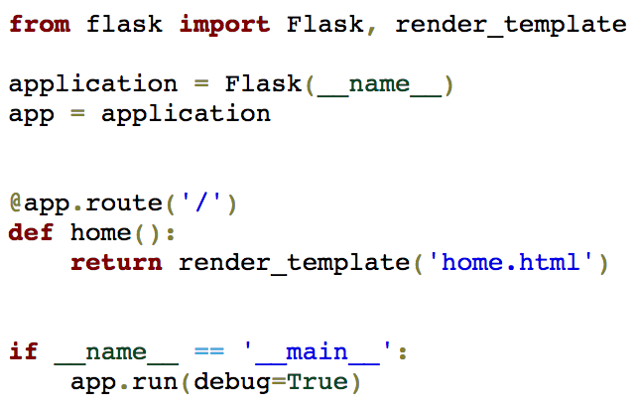
Flask
Notes:
If using, reco is Flask
Simple enough
Structured enough to learn from looking & working
This is the WSGI for flask
Use it to demo main funcs of web framework

Slide 96

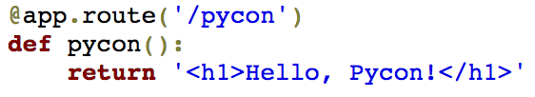
URL routing
Notes:
Framework provides easy way to specify how to match a URL from the browser to code
Here have defined route that will render this HTML, and you can do this easily with a decorator and a function because of flask
Once WSGI takes place and matches a URL to an app-defined route, your app will need to know how to match that route to the corresponding piece of code. This isn’t as simple as it sounds! Your framework configuration will indicate in which files to look to find any given handler or function, and will provide a simple function as an interface to let you designate where to look.

Slide 97
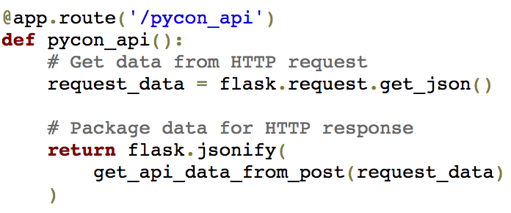
Request and response objects
Notes:
Converts incoming HTTP req into POPOs
Code can easily access key info
On way out, converts responses into HTTP resp that browser can read
Your framework will also take care of converting incoming HTTP requests into Python objects so that your code can easily access key information about the request. Similarly, on the way back out, your framework convert your responses into HTTP responses that the browser can read.

Slide 98
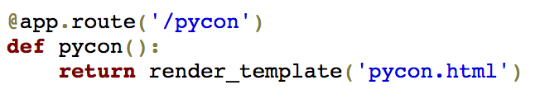
Template engine
Notes:
Allows you to pass values from data to HTML
I.e. Can pass vars directly into HTML from python just as function rather than parsing HTML string
Also individual pkgs that serve solely as template engine
Can use instead of or in addition
Web frameworks also often come with a template engine that allows you to pass values from your data model into your HTML. In other words, you can pass variables directly into your HTML from Python as you would variables into a function rather than having to format an HTML string or something like that
There are also individual python packages that serve solely as a template engine that you can use either instead of or in addition to the template engine provided by your web framework.

Slide 99
Development web server
Notes:
Ability to spin up dev web server to test changes locally
Sometimes docu is unclear, but typically
Finally, frameworks come with the ability to spin up a development web server so that you can test out your changes locally. Sometimes it’s difficult to tell in the documentation how exactly you do this, but typically

Slide 100
$ python <file_name>
$ jekyll serve
Notes:
Involves running file directly
Or custom command
It involves either running a file directly from your command line, or running some custom command that you can find somewhere in the documentation. For example, jekyll, a popular framework for static websites like blogs, uses the command `jekyll serve`
From there, you navigate to your localhost in your browser. Often, the output of these commands will tell you exactly what IP and port to type into the browser.

Slide 101
mary.nagle flaskapp [master] python app.py
* Running on http://127.0.0.1:5000/ (Press CTRL+C to quit)
* Restarting with stat
* Debugger is active!
* Debugger PIN: 218-987-530
Notes:
On flask, run file
Output tells IP and port of localhost wher it’s running

Slide 102
File structure
Notes:
Last thing just in case you’re curious
Web frameworks set up skeleton file struc for you
Django & Flask are popular
The last aspect to consider on frameworks is file structure. Like all python packages, frameworks come with a set of folders and files that make up what they do. You can add to this skeleton to build out your app. Two popular web frameworks for Python are Django and Flask, and here’s how they look

Slide 103
Django Default File Structure
project_folder/ manage.py
requirements.txt configuration_stuff/ __init__.py settings.py urls.py wsgi.py
app_name/
__init__.py
models.py
[other files for MVC]
Notes:
INTERACT WITH SLIDE
Django keeps most of its configuration files in a separate folder alongside the application code

Slide 104
Flask Recommended File Structure
project_folder/
config.py requirements.txt app.py instance/ config.py yourapp/ __init__.py views.py models.py forms.py static/ templates/
Notes:
INTERACT WITH SLIDE
While flask keeps them mostly out in the open in the same parent folder as the application code
There’s not really a right way to do this, you just have to make sure the right configuration variables point to the correct file path

Slide 105
Flask
Notes:
SRSLY, Use flask you’ll be good
There’s a bunch of frameworks out there, but if you’re going to start with one, start with CLICK Flask, because it’s simple enough for beginners, but still structured enough that from looking at it and working with it you can learn how each part of it helps your app run.
When using flask, you learn very quickly how it accomplishes WSGI and the four components I mentioned before.

Slide 106
“Flask tutorial”
Notes:
You can learn to use flask by searching Flask tutorial
When it comes time...

Slide 107
- URL routing -
- Request and response objects -
- Template engine -
- Development web server -
Notes:
For your own recipe, important thing =
suits needs of apps
Makes life easier
Look at four key purposes
Consider whether and how well
To learn how to set it up...
For when you decide to make your own recipe and sub in a different framework: The important thing to consider when choosing a framework is that it serves the needs of your application and makes your life easier as a developer. If you take a look at whether and how well they serve these four key purposes, that can help you make your decision.

Slide 108
Final Product
Your operating system
virtualenv
Flask App
Packages
SQLite Database
Web Server
Notes:
Once you get that set up, things look sorta like this
Not connected
This is one of many ways you could set things up. If you want, your DB and your web server can both live inside your virtual environment, and there are plenty of other ways - it’s really a matter of your preference and what makes sense to you

Slide 109
What You’ll Learn
Package installation
Virtual environment
Data storage
Framework
Tying your components together
Connecting your app to the web
Notes:
Finish with tying together
Cover both new stuff and ref earlier topics
Finish off with how to tie this all together inside your application, and here we’ll cover some new stuff while also referencing earlier topics from this talk

Slide 110
settings.py, config.py...
Notes:
File responsible for most of connections
Devine db vars
Tell app where to find db
IP of server, or file path to sqlite db on disk
Also indicates
Hostname for server to deploy to for each env
Credentials to and location of other external (S3, Twitter)
Path to project from root
The file responsible for most of that is usually called settings.py, or config.py, something along those lines. This file is responsible for defining database variables that will tell your app where to find your database, whether that’s the IP of the server running your database, or the file path to your sqlite database on disk.
Info in this file also can indicate how to access the development server, where to find any other external tools you are using, and the path to your project from the root of your system.

Slide 111
requirements.txt
Notes:
Servers that run app can use to determine which versions to download
Any server that runs your app will know which packages you need and which versions to download thanks to the requirements.txt file

Slide 112
$PATH
Notes:
Once installed, $PATH tells where
Once those are installed, your $PATH variable will indicate where to find the executables to make those packages actually run

Slide 113
__init__.py
Notes:
Empty file that does nothing but tell compiler it’s python
Makes sure files aren’t ignored
Then there’s the __init__.py file, which is usually an empty file that does nothing other than say to your python compiler, “hey, this folder I’m in? It’s a python directory.”
Basically, its presence makes sure those files aren’t ignored.

Slide 114
Look for __main__
Notes:
To see WSGI, look for name == main
Won’t explicitly mention WSGI
Where web server’s request first makes contact w/ app code
Finally, the holy grail of WSGI and how it’s set up. If you want to see WSGI in your app, you can often find it in the same file that calls the `if __name__ == ‘__main__’ statement.
It won’t necessarily explicitly mention WSGI, but this file is where the web server’s request first makes contact with your application code.

Slide 115
What You’ve Learned
Package installation
Virtual environment
Data storage
Framework
Tying your components together
Connecting your app to the web
Notes:
Covered it all
Hopefully demystified
Here’s setup
With that, we’ve covered each piece you need to start an application, and hopefully this has demystified these components. Here’s how your setup looks now

Slide 116
Final Product
Your operating system
virtualenv
Flask App
SQLite Database
settings.py
requirements.txt
Packages
WSGI.py
Web Server
Notes:
Here’s how setup looks, and if you need help getting here, google
This is one of many ways you could set things up. If you want, your DB and your web server can both live inside your virtual environment, and there are plenty of other ways - it’s really a matter of your preference and what makes sense to you

Slide 117
“Build and deploy a python website using Flask and SQLite”
Notes:
What I showed at beginning - build and deploy a python website using flask and sqlite to learn to weave all together

Slide 118
Final Product
Your operating system
virtualenv
Flask App
SQLite Database
settings.py
requirements.txt
Packages
WSGI.py
Web Server
Notes:
One of many
E.g. db & server can live in venv
Can sub out any of these for another tech
Can add things
Matter of preference and what makes sense to you
This is one of many ways you could set things up. If you want, your DB and your web server can both live inside your virtual environment, and there are plenty of other ways - it’s really a matter of your preference and what makes sense to you

Slide 119
RECAP TIME
Notes:
To boil down into what you can take away today

Slide 120
Step Recommendation
Virtual environment
virtualenv
Notes:
Research and choose the virtual environment that works for you
If you don’t know where to start, use pip to install virtualenv

Slide 121
Step Recommendation
Virtual environment
Data storage
virtualenv
SQLite
Notes:
Decide how you want to store your data and set that up
For beginners, stick to sqlite

Slide 122
Step Recommendation
Virtual environment
Data storage
Framework
virtualenv
SQLite
Flask
Notes:
And choose a web framework that seems like it will be the easiest to understand, so that you can learn from it for next time.
My favorite for if you don’t want to be overwhelmed but still want to learn something, is Flask

Slide 123
Step Recommendation
Virtual environment
Data storage
Framework
pip install virtualenv
SQLite
pip install flask
Notes:
Use pip to install any packages
Sample recipe
Once comfortable, can sub out for own ingredients
Use what you’ve learned from talk & experience to make informed decisions on which ingredients will work best for you
Now that these steps & terms have been unmasked and demystified
You will be better prepared to navigate the overwhelming of unhelpful information out there on this
And understand helpful info when you come across it

Slide 124
Knowing what to google is half the battle.
Notes:
Remember
But really, the biggest and most helpful takeaway, is knowing what to google. Now that you have this sample recipe to start with, you can google for those specific technologies to get help setting them up and weaving them together. When you feel comfortable, you can sub those out for your own ingredients, and you can use what you’ve learned from this talk and your experience to make informed decisions on which ingredients will work best for you.

Slide 125
Sources
https://pip.pypa.io/en/stable/reference/pip_install/#usage
https://www.recurse.com/blog/14-there-is-no-magic-virtualenv-edition
https://www.digitalocean.com/community/tutorials/sqlite-vs-mysql-vs-postgresql-a-comparison-of-relational-database-management-systems
http://pythonpaste.org/do-it-yourself-framework.html
https://howdns.works/
http://www.revsys.com/blog/2014/nov/21/recommended-django-project-layout/
https://docs.djangoproject.com/en/1.9/intro/tutorial01/
http://damyanon.net/flask-series-structure/

Slide 126
Questions?
Please don’t hesitate to contact me:
email: naglemaryk@gmail.com
Github & Twitter: @naaaargle (4 A’s)

